Slide 1
CHAPTER 3
Multidimensional grids and
data

Slide 2
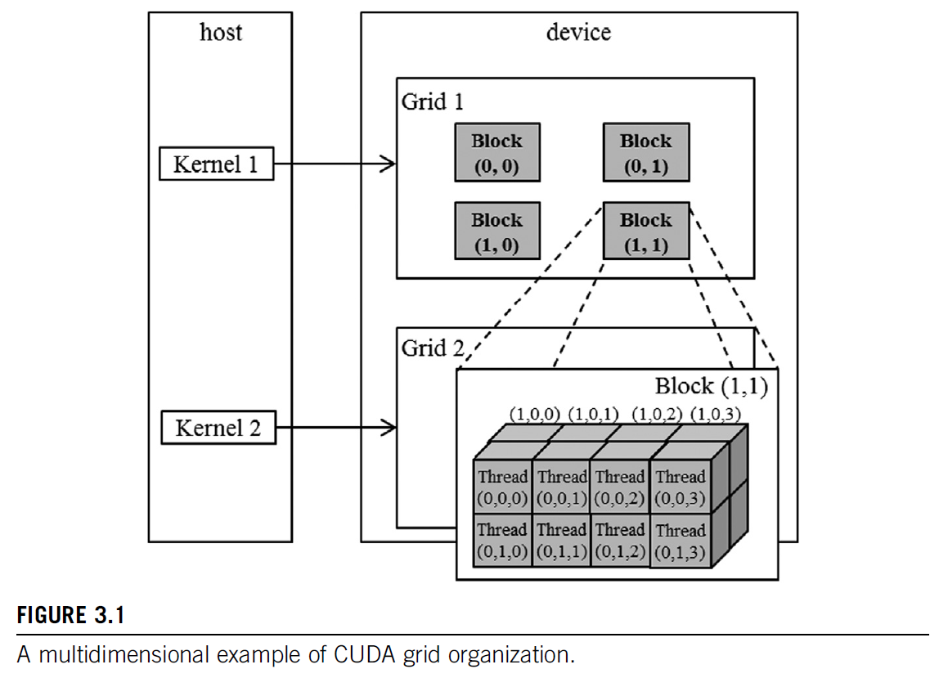

Slide 3
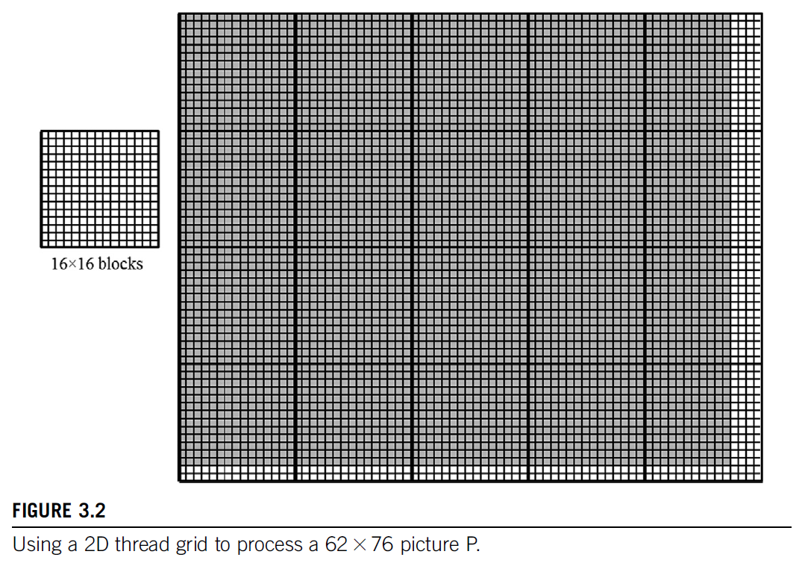

Slide 4
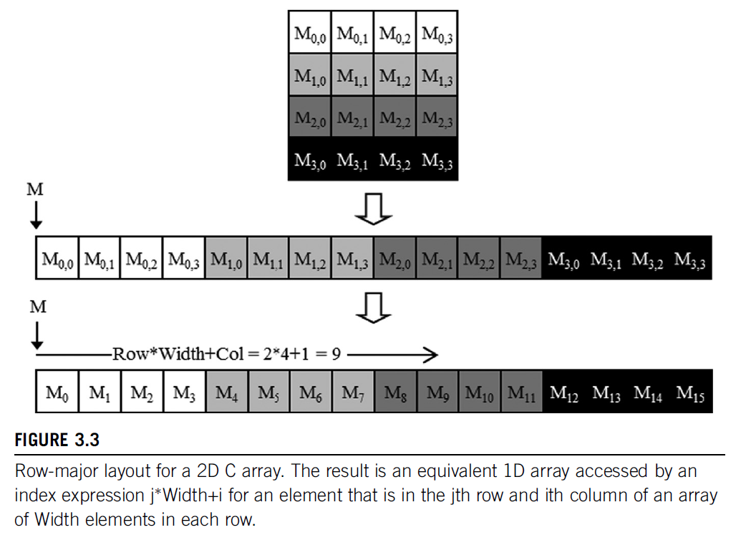

Slide 5
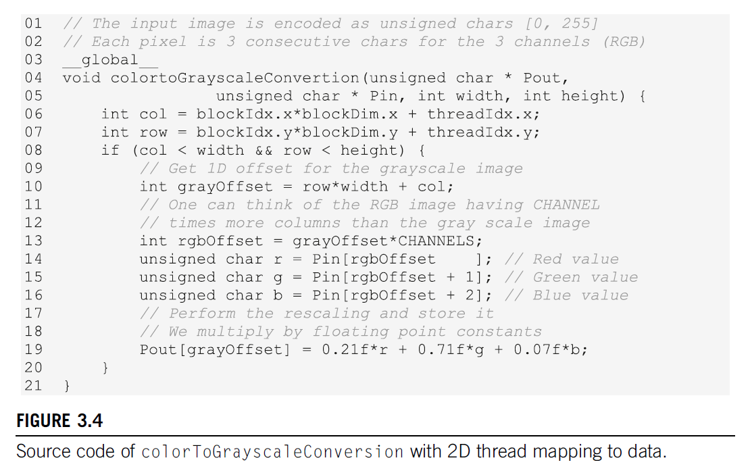

Slide 6
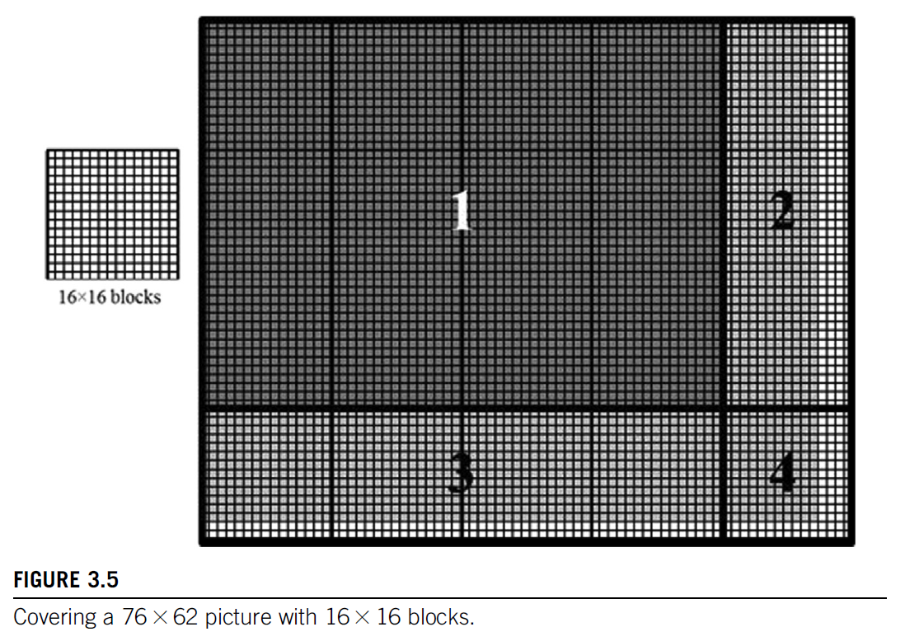

Slide 7
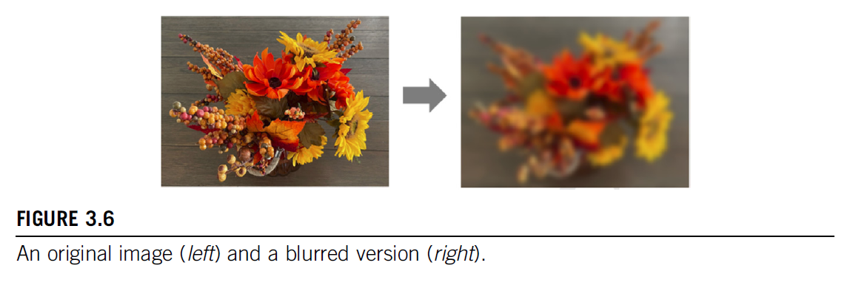

Slide 8
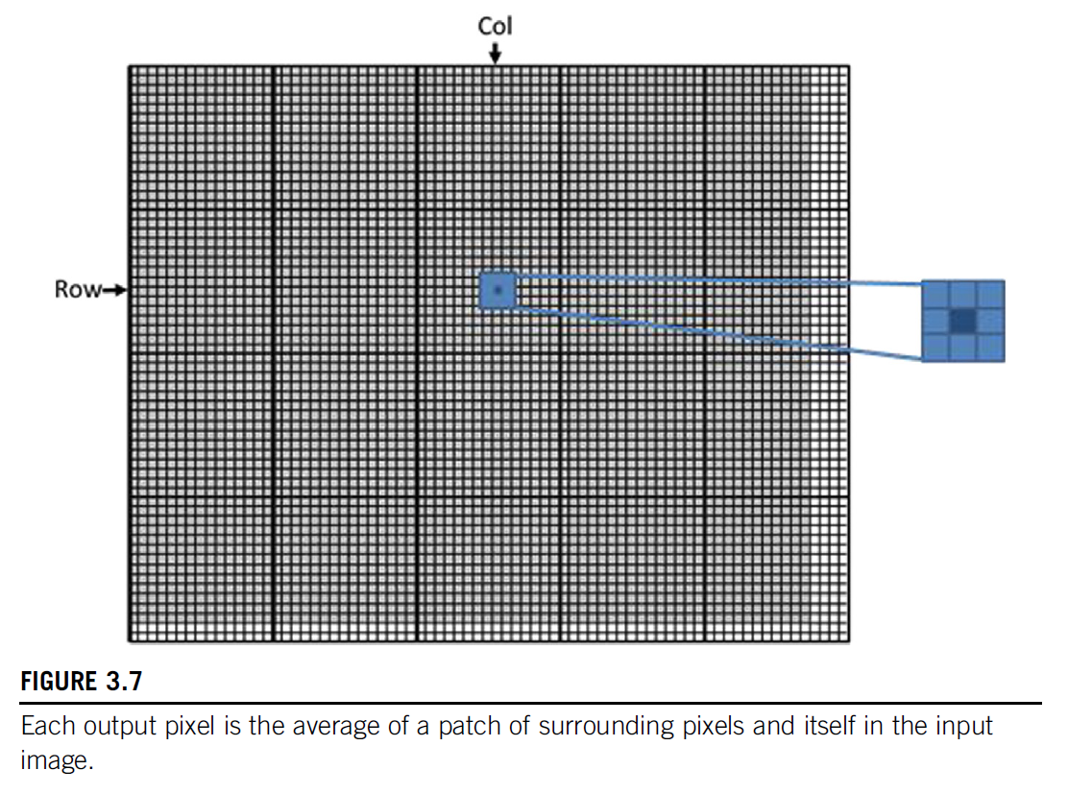

Slide 9
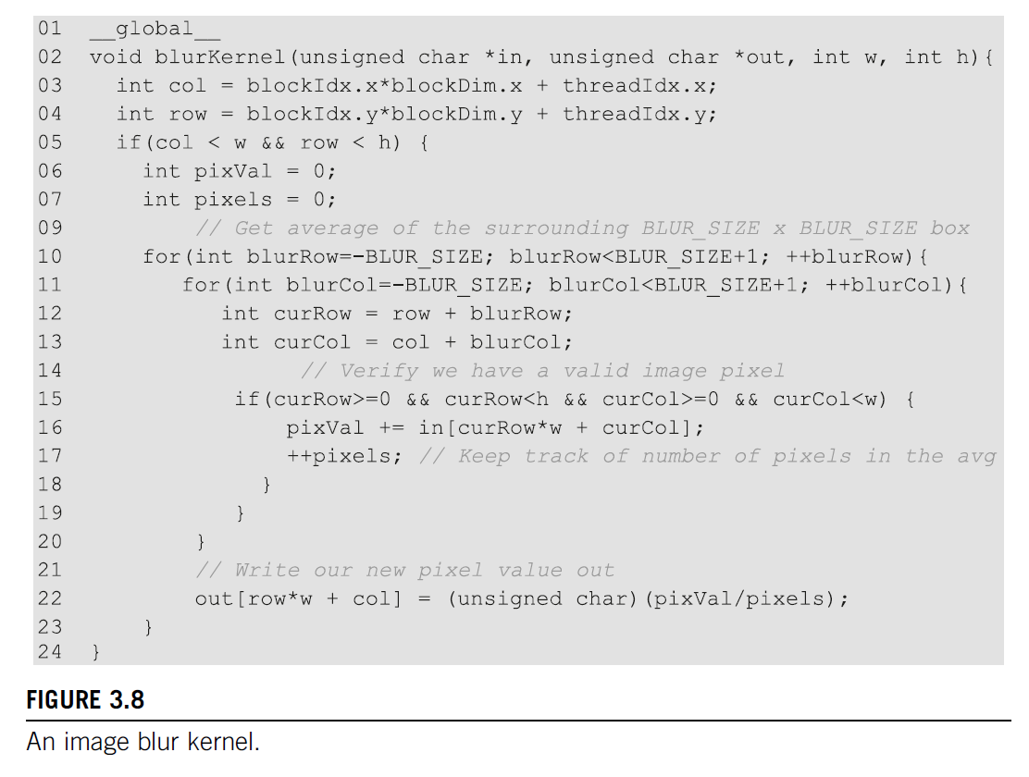

Slide 10
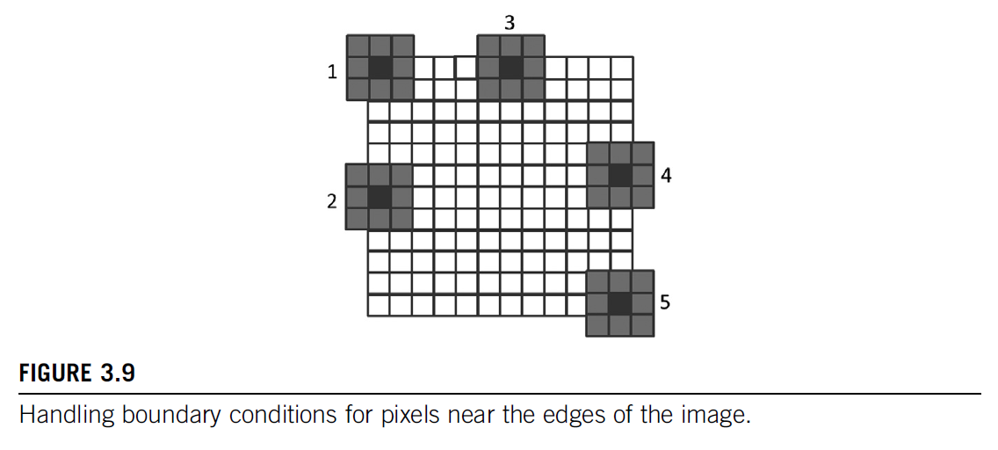

Slide 11
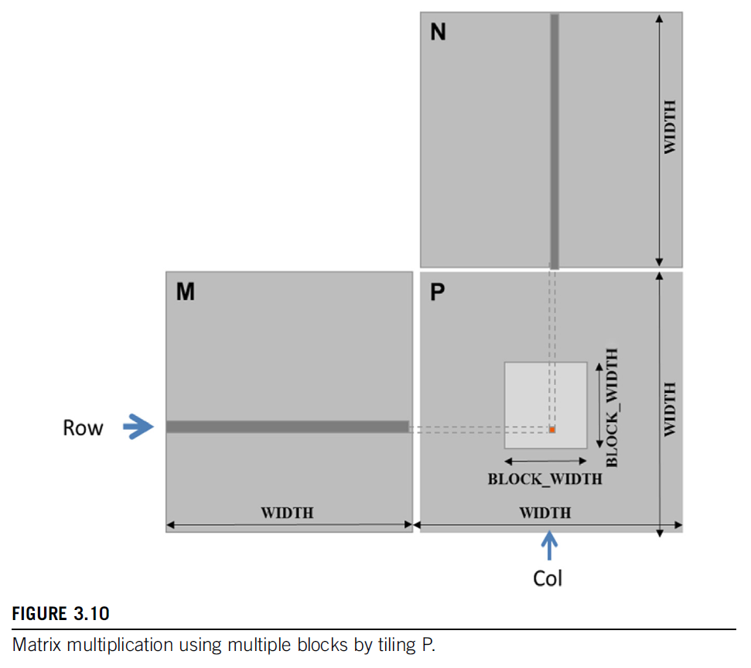

Slide 12
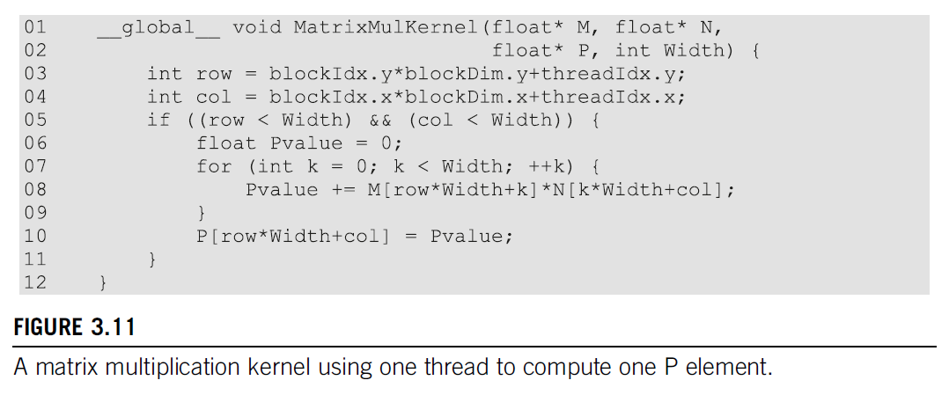

Slide 13
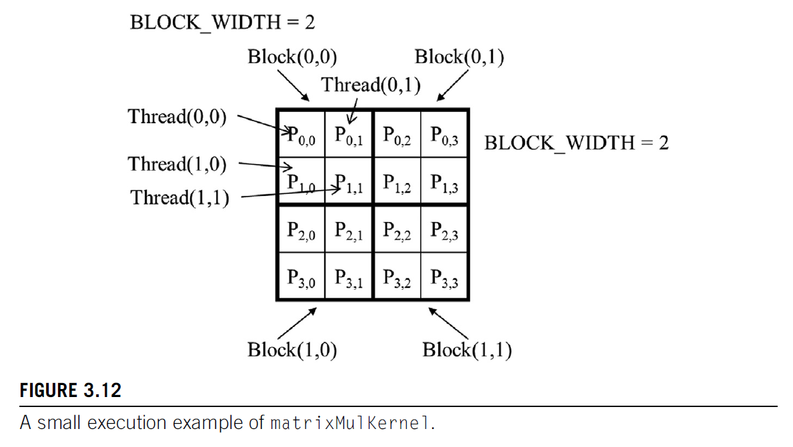

Slide 14
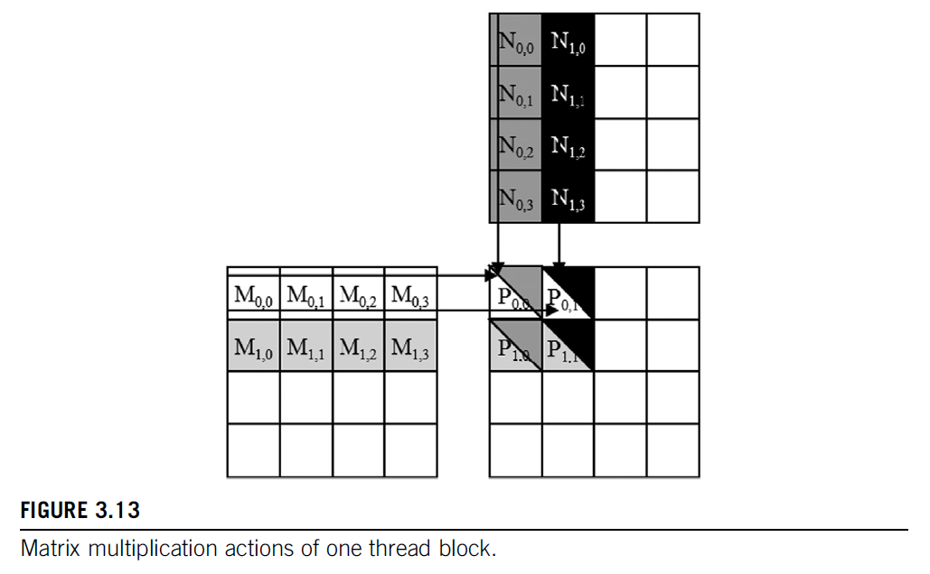

Slide 15

In-text figure 1

Slide 16

In-text figure 2

Slide 17

In-text figure 3

Slide 18

In-text figure 4

Slide 19

In-text figure 5

Slide 20

In-text figure 6

Slide 21

In-text figure 7

Slide 22

In-text figure 8

Slide 23

In-text figure 9

Slide 24

In-text figure 10

Slide 25
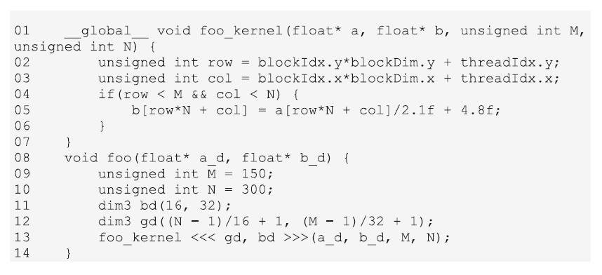
In-text figure 11

